Slide 1
Creating an APP
Lesson 2/3
Learning the basic skills for APP development

Slide 2




Starter
Can you figure out what these APP’s are?

Slide 3
DID YOU GET THEM ALL?
Skype
YouTube
Trip Advisor
Instagram

Slide 4
WALT and WILF
WALT – Create an APP on a specialised piece of software
WILF – An attempt at creating different features within an APP (external links, map points, forms, e-mail links, images, buttons)

Slide 5
APPShed
Learning to design an APP and what we can do
We will follow the pdf file to start with so that we can design a basic school APP.
Follow each step to design a simple school APP!
Sheet needed – Walkthrough of APPShed

Slide 6
Work Independently
Follow the pdf file
Work Independently
Learn the skills of how to build an APP
Mark on the sheet what you have completed successfully and what you have struggled with!
Sheet needed – My Success

Slide 7

Got it Sussed?
Thumbs Up – if you think you have got it!
Thumbs Level – if you are unsure
Thumbs Down – if you just don’t get it

Slide 8
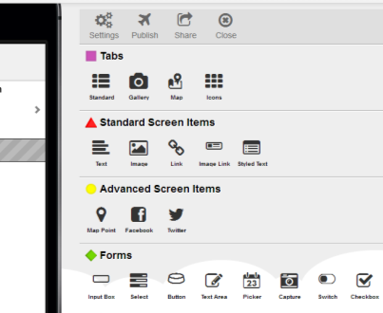
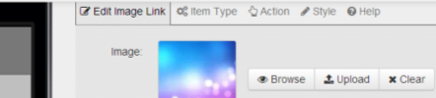
Working through the pdf file
Take it step-by-step!
Follow every direction… use your common sense!
Choose what you want to create (links to websites/forms etc.)
Make your way along each of the TAB’s for each section and EDIT what you need to!

Slide 9
Plenary
What was a success?
What did you find hard?
On the piece of paper put your full name, a success and a difficulty you have had today.
Be prepared to share and hand these in!

